Slide 1

The Sporty 4
Marcel Englmaier
Aaron Huntoon
Andrew Horner
Chris Diacono

Slide 2




Introduction

Slide 3
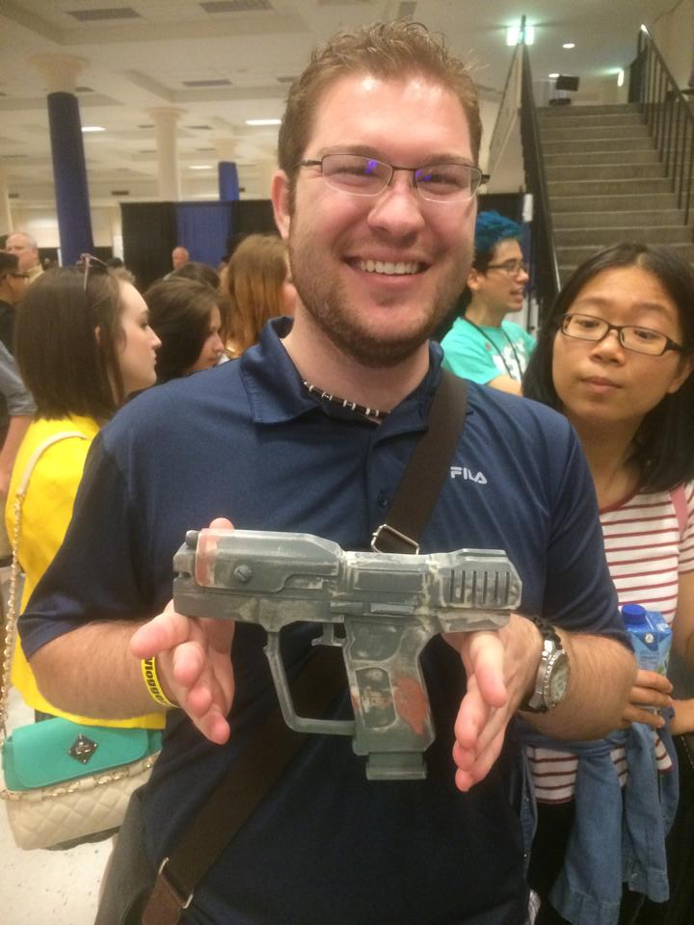
Marcel Englmaier
Senior
Portage, MI(but emmigrated from Germany)
Major – Computer Science
Minor – Being a badass(and goofing off)

Slide 4
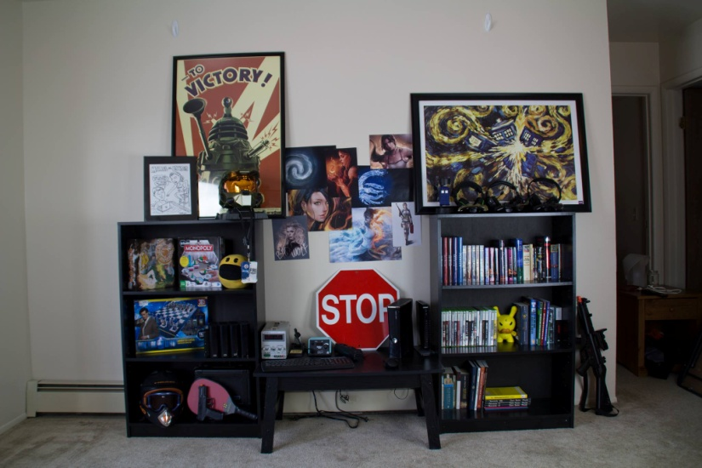
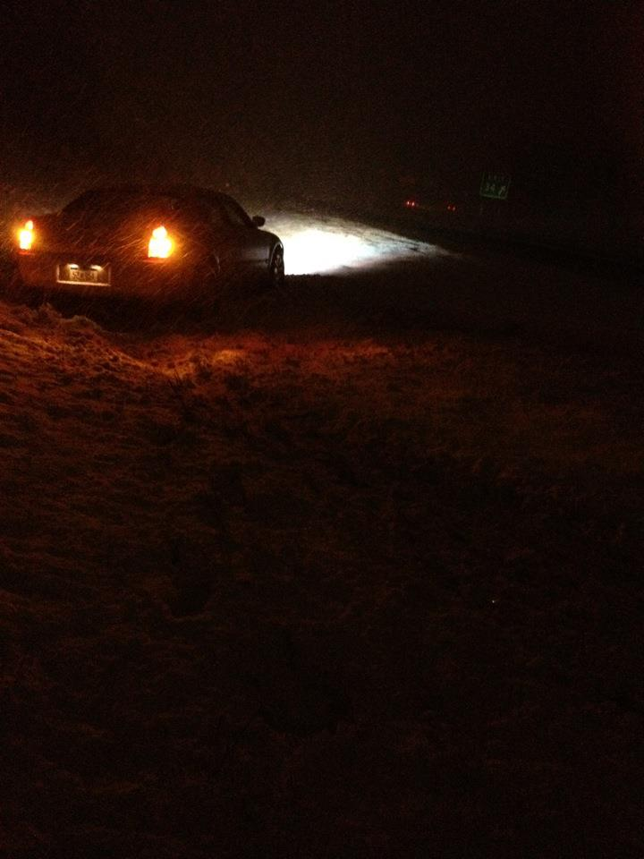
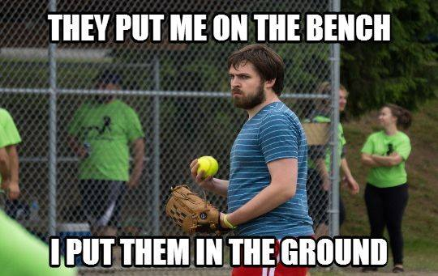
About Marcel

Slide 5
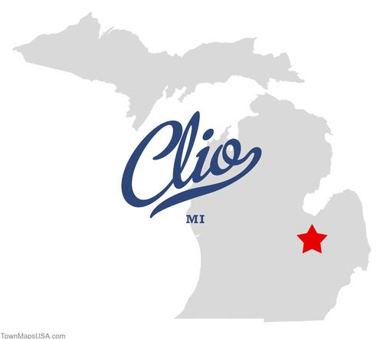

Aaron huntoon
Major: Engineering Management Technology
Senior
Born January 8th, 1993
From Clio, MI

Slide 6
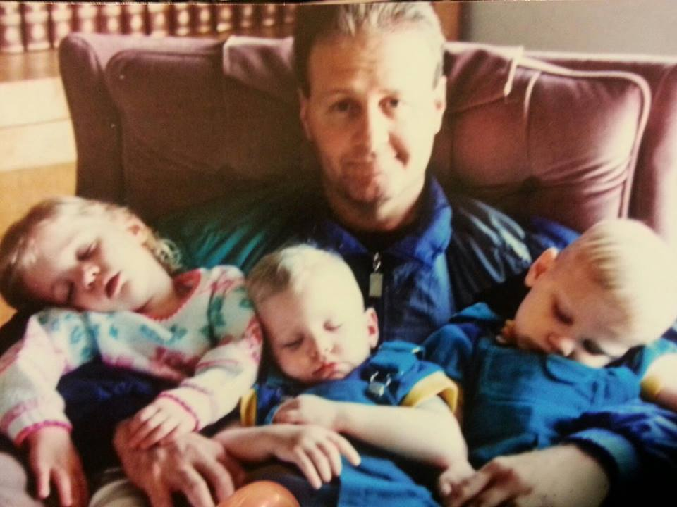
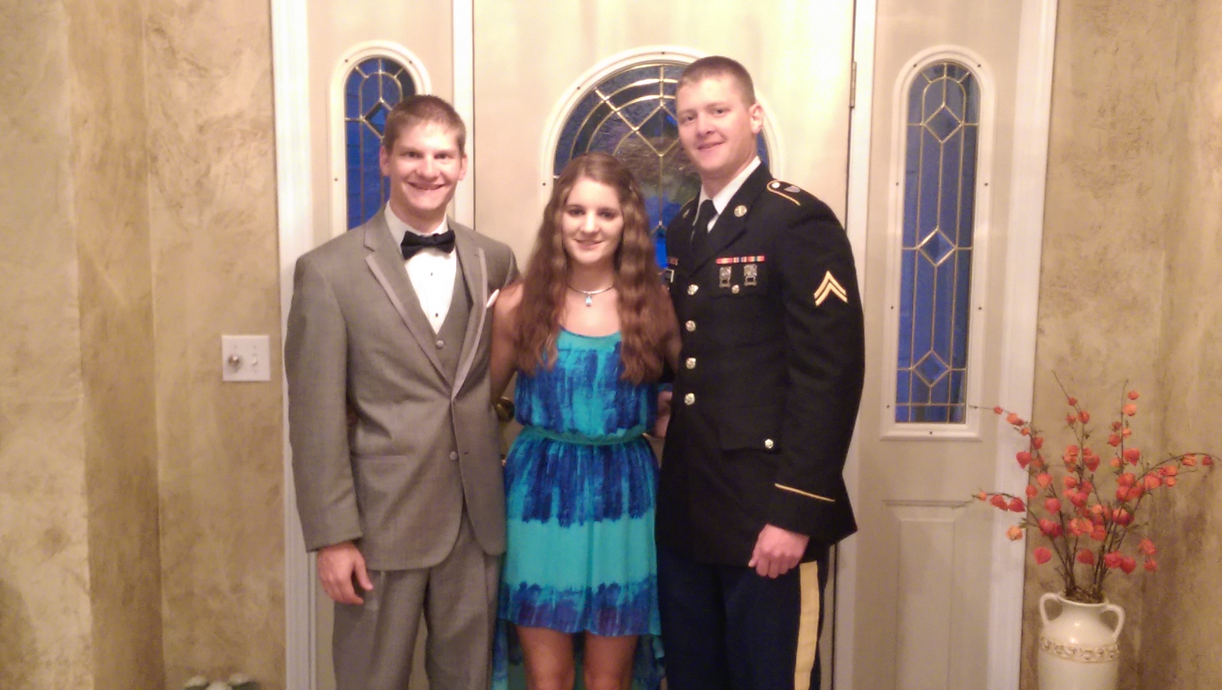

Slide 7
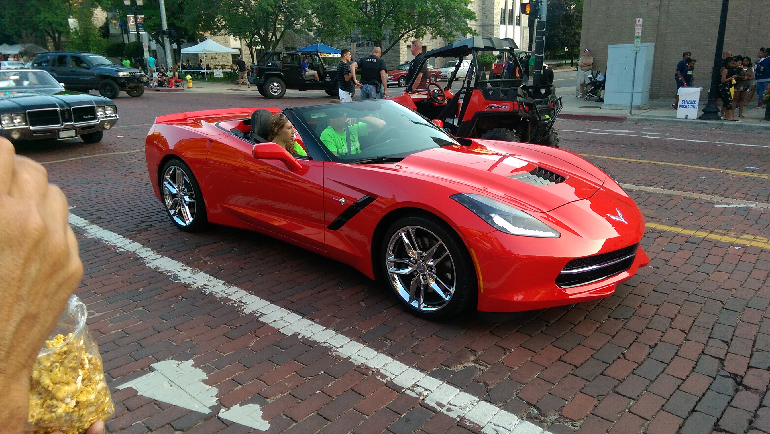
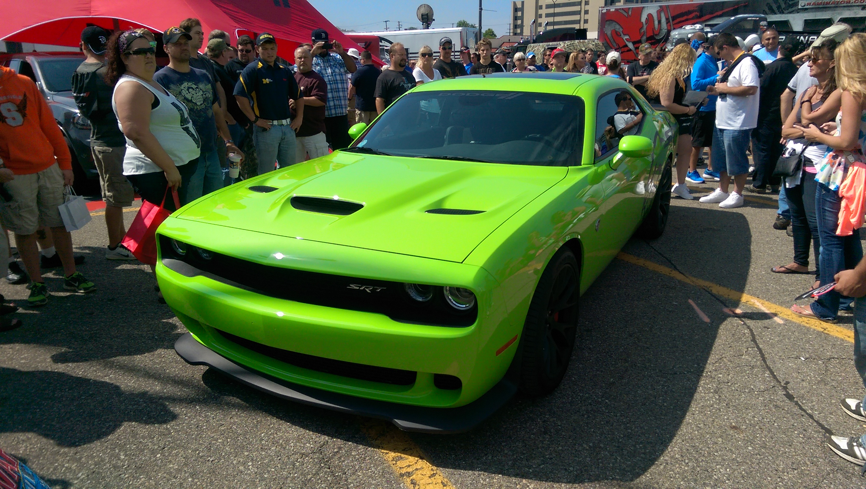
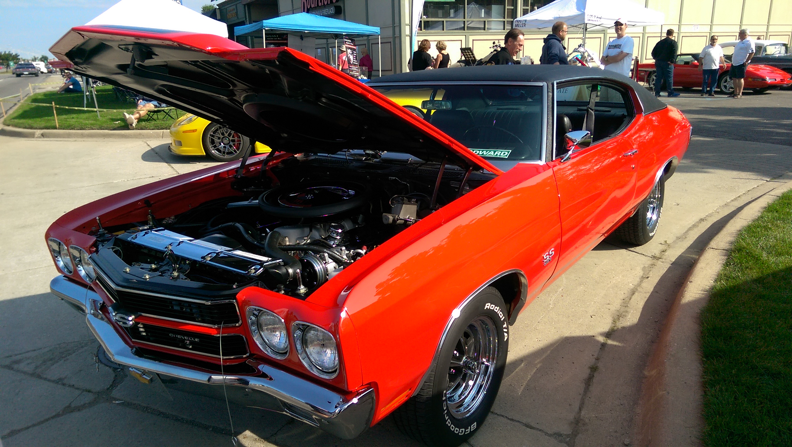

Slide 8
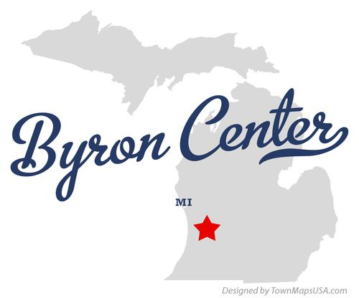
Andrew Horner
Senior
Byron Center, MI
Major - Engineering Management
Technology
Minor - General Business

Slide 9
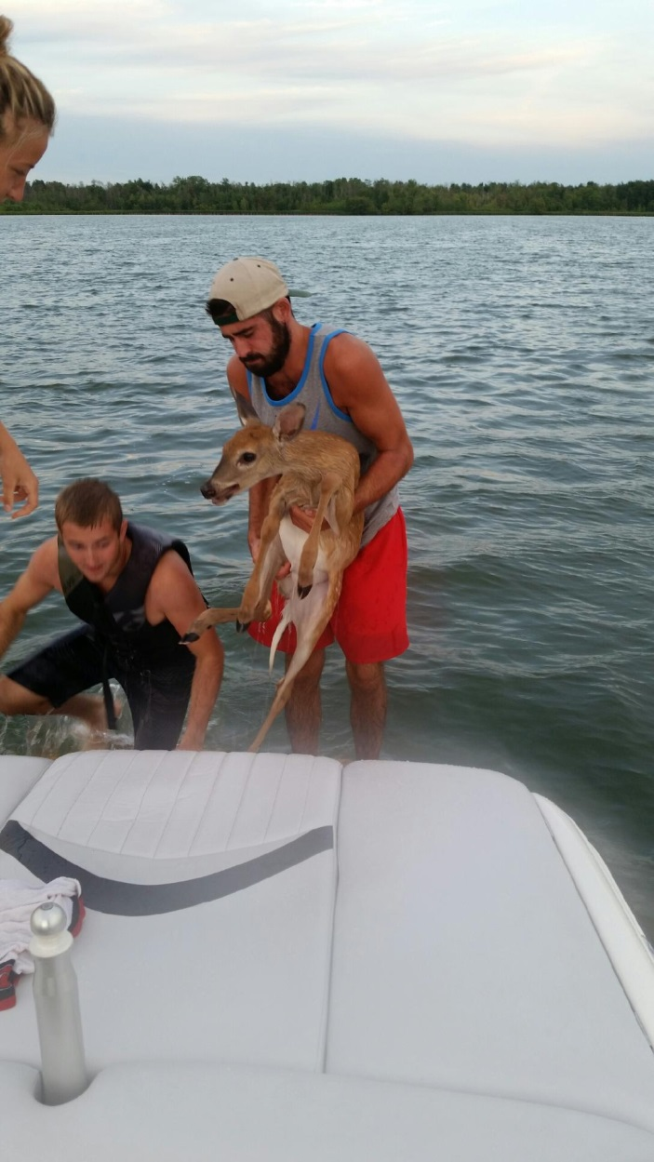
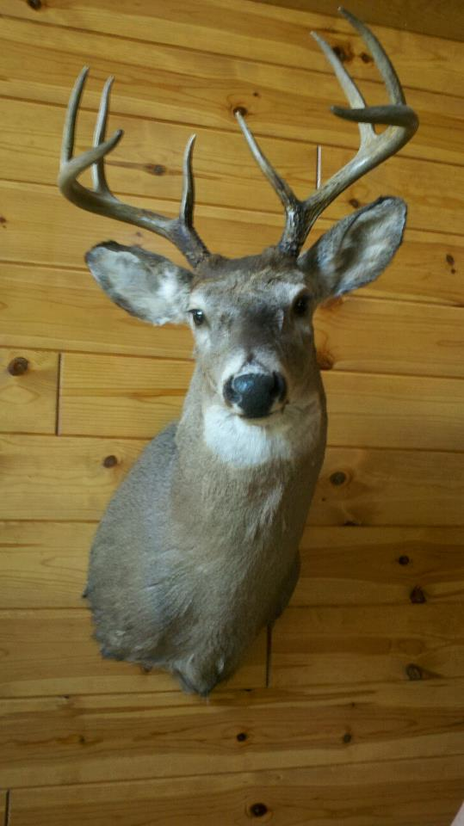
About Andrew

Slide 10
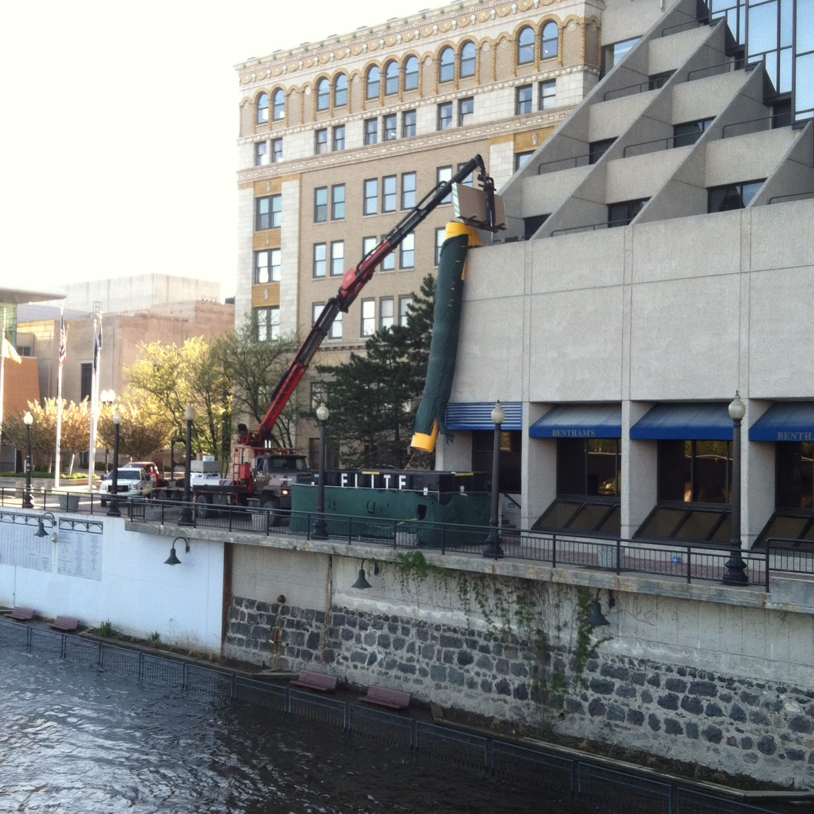
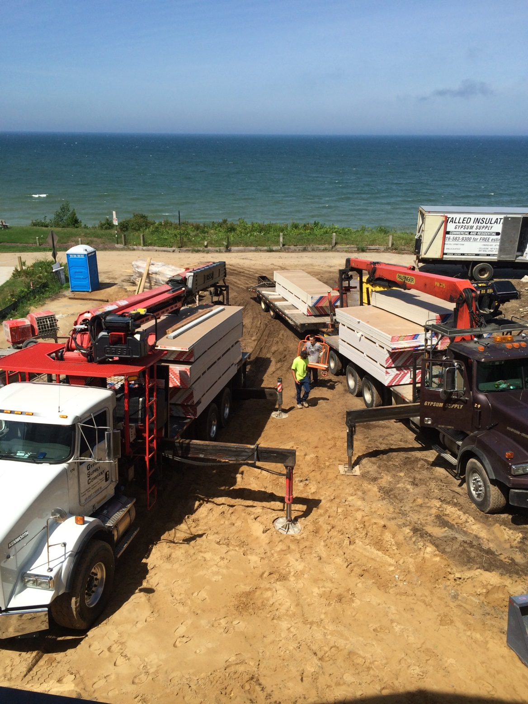

Slide 11
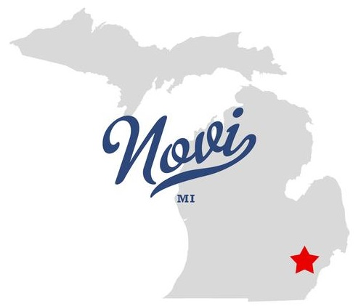
Chris Diacono
Junior
Major - Engineering Management Technology
Minor - Manufacturing
From Novi, MI
Intern at JIER

Slide 12

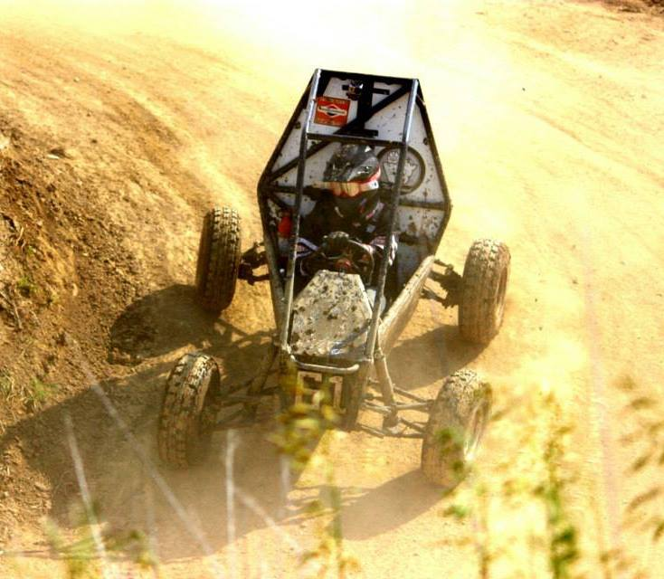
About Chris

Slide 13
Any questions?

